Slide 1
Predictive Analysis of Football Player Performance
Student Name: | Anmol Singh
Student Id: | u3263160
Theme: | Data Analytics, Visualization, Prediction and Deployment

Slide 2


Introduction
Objective:
To develop a predictive model that accurately forecasts football players performance ratings based on their historical and physical data.
Importance:
Aid sports analysts and fantasy league participants in making informed decisions.
Enhance team management and player selection strategies through data-driven insights.
Approach:
Utilized machine learning techniques to analyze extensive player data and identify key performance predictors.

Slide 3
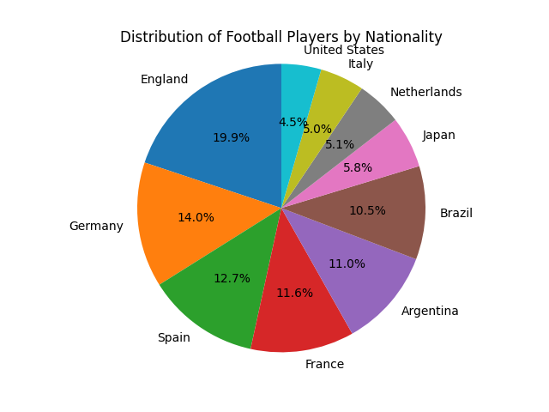
Dataset Overview
Source:
Data compiled from global football statistics databases and sports analytics firms.
Composition:
Features include age, nationality, club, performance stats such as goals, assists, and defensive actions, along with overall performance ratings.
Volume :
Utilized machine learning techniques to analyze extensive player data and identify key performance predictors.
Relevance:
Comprehensive player data allows for effective modeling of performance trends and predictors.

Slide 4




Methodology Overview
Data Cleaning:
Removed irrelevant columns and handled missing values to optimize the dataset for analysis.
Feature Selection:
Applied SelectKBest to determine the most impactful features for our model.
Model Building :
Tested various regression models, evaluating their accuracy through performance metrics.

Slide 5
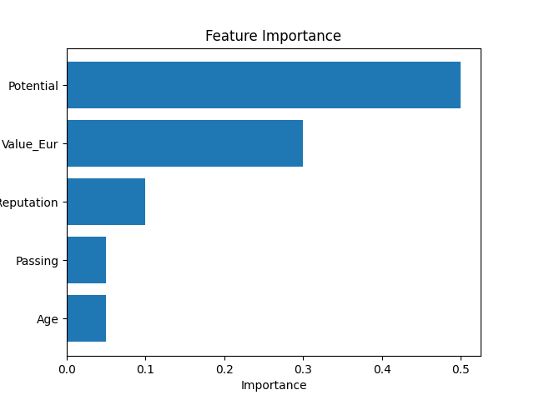
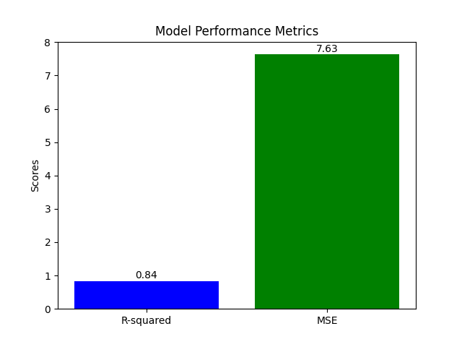
Key Findings
Top Features:
'Potential' and 'Value_Eur' significantly impact players' ratings, as identified through statistical feature selection.
Model Performance:
Achieved an R-squared of 0.838, validating the model's predictive accuracy.
Cross-validation confirmed model consistency with an average R-squared of 0.952.

Slide 6
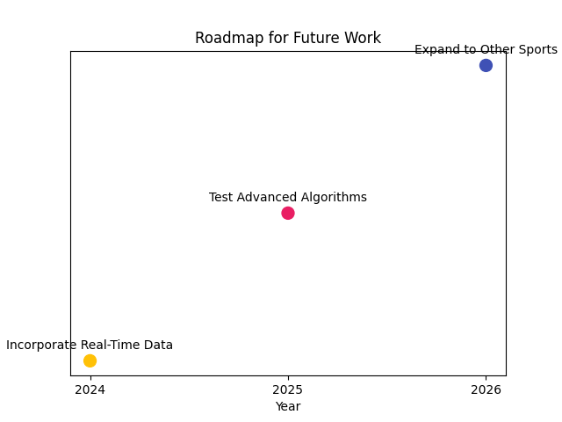
Conclusion & future Work
Summary of Findings:
Successfully identified key predictors of player performance, with 'Potential' and 'Value_Eur' being top influences.
Achieved a robust model with an R-squared of 0.838, demonstrating strong predictive power.
Significance:
These insights empower sports professionals to make data-driven decisions, enhancing player recruitment and team strategy.
Practical Applications:
Potential integration into sports analytics software for real-time player evaluation.
Future Work:
Explore incorporating dynamic performance data and advanced predictive algorithms.
Investigate model applications in other sports.
Call to Action:
Leverage this model in your analytical strategies and contribute to its evolution.

Slide 7
THANK YOU

